Slide 1
Introduction to LiDAR
Magnus Bremer
This is an open access presentation under the CC BY license (http://creativecommons.org/licenses/by/4.0/)

Slide 2
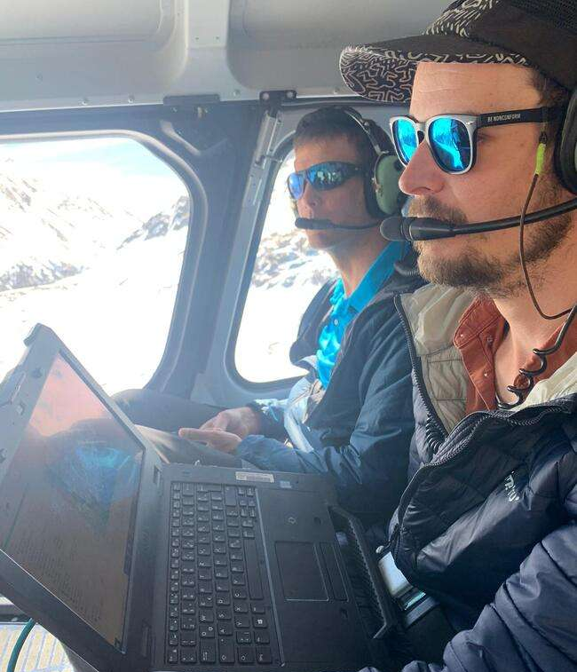
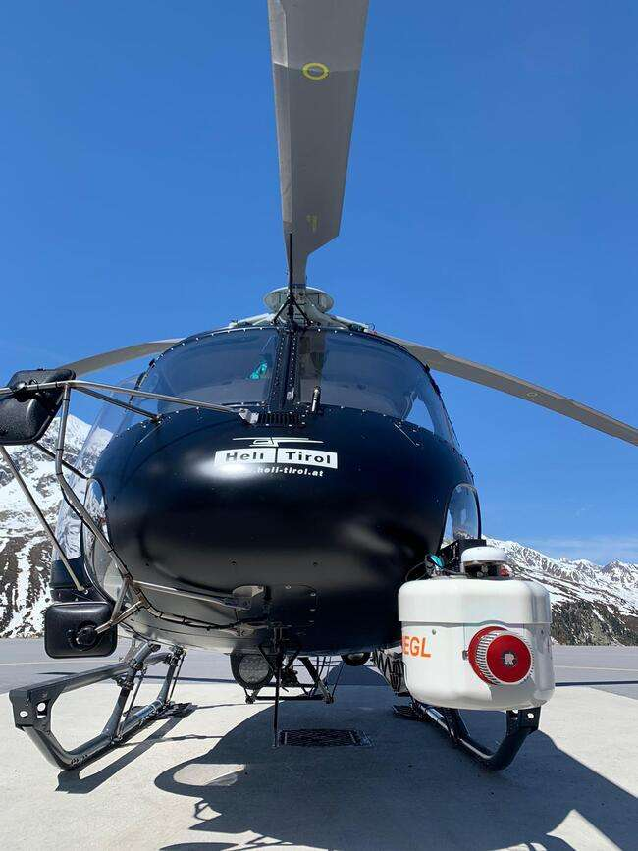
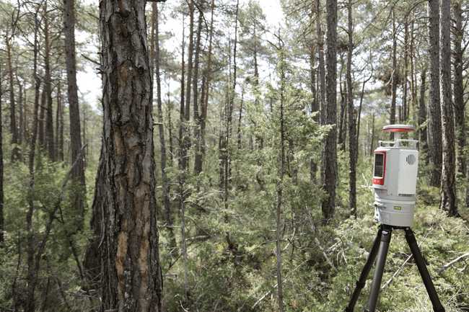
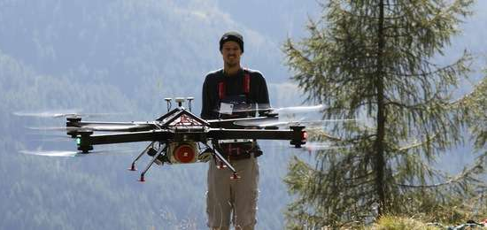
Introduction to LiDAR
My personal LiDAR background
Since 2009: Terrestrial Laser Scanning
Since 2017: UAV Laser Scanning
Since 2021: (DIY) Airborne Laser Scanning

Slide 3
Introduction to LiDAR
Outline
The range measurement
From ranges to point clouds
From point clouds to scan projects
Laser beam characteristics
Laser intensity data
Platforms and scales

Slide 4
Introduction to LiDAR
Some LiDAR Literature:
Vosselman, G., Maas, H.-G. (2010): Airborne and terrestrial laser scanning. CRC Press, 318 p.
Shan, J., Toth, C.K. (2018): Topographic laser ranging and scanning principles and processing. CRC Press, 654 p.

Slide 5
Introduction to LiDAR
Terminology:
LASER Light Amplification by Stimulated Emission of Radiation
LIDAR Light Detection And Ranging (analogy to RaDAR)
► active remote sensing technology
► distance measurement
► static (terrestrial) vs. kinematic (mobile, UAV, airborne)

Slide 6
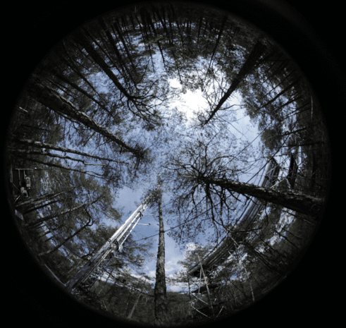
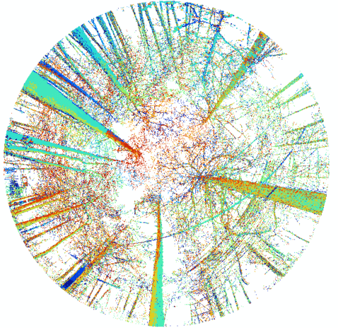
Introduction to LiDAR
Active vs. Passive Remote Sensing:
day: photograph
day: LiDAR
night: photograph
night: LiDAR

Slide 7
Introduction to LiDAR
Active vs. Passive Remote Sensing:
A passive sensor measures reflected sunlight emitted from the sun.
► optical, multi-spectral sensors
► dependent on daylight and weather conditions
An active sensor has its own source of light or illumination. It actively sends light and measures the backscattered signal.
► LIDAR, RADAR (transit time measurement, phase measurement)
► independent of lighting

Slide 8
Range measurement
This is an open access presentation under the CC BY license (http://creativecommons.org/licenses/by/4.0/)

Slide 9
Introduction to LiDAR
time of flight of a laser pulse
A laser pulse is send out and detected again…
The travel-time is measured
[source: Kahlmann et al. 2006]

Slide 10
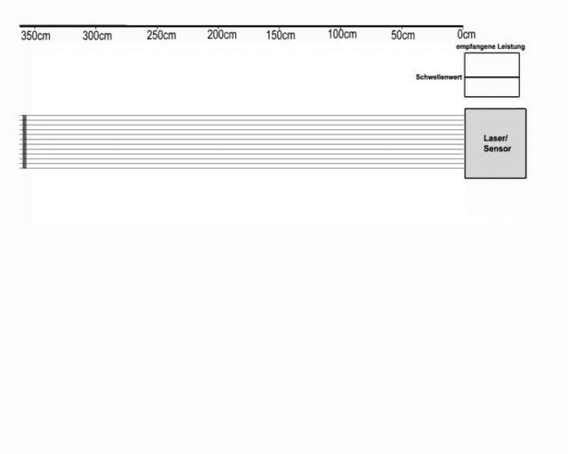
Introduction to LiDAR
time of flight of a laser pulse
A laser pulse is send out and detected again…
The travel-time is measured
animation

Slide 11
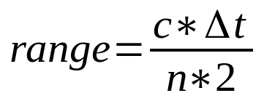
Introduction to LiDAR
Measurement principles of laser scanners:
► light transit time measurement (from sensor to reflecting object and back): “time-of-flight” measurement
c = speed of light in vacuum
Δt = travel time
n = correction factor, equal to the refractive index (for air ~ 1.00025)
► phase measurement (different realization of time-of-flight measurement using phase differences)
► triangulation (construction of a triangle from illumination direction, observation direction and baseline)

Slide 12
Introduction to LiDAR
Continuous wave / phase shift
Signal Modulation
Comparing the outgoing and incoming phase
The shift allows to compute the distance.
[source: Kahlmann et al. 2006]

Slide 13
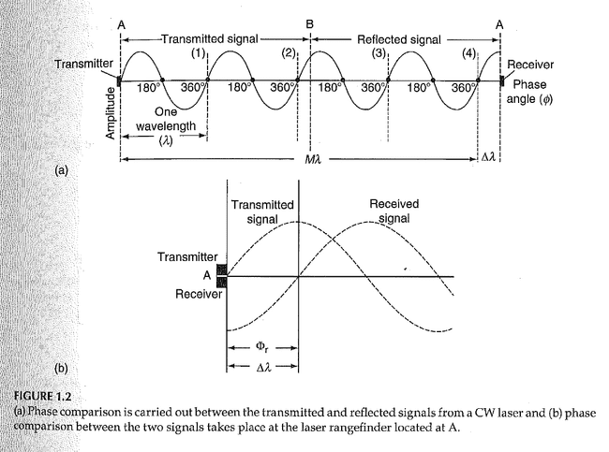
Introduction to LiDAR
Continuous wave / phase shift
Signal Modulation
Comparing the outgoing and incoming phase
The shift allows to compute the distance.
[source: Topographic laser ranging and scanning: principles and processing / edited by Shan & Toth, 590pp.]

Slide 14
From ranges to point clouds
This is an open access presentation under the CC BY license (http://creativecommons.org/licenses/by/4.0/)

Slide 15
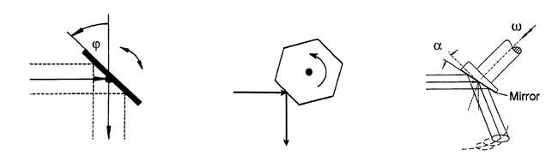
Introduction to LiDAR
From range measurements to scan profiles
A deflecting rotating/oscillating mirror manipulates the laser beam direction
oscillating rotating palmer scanner
WEHR, A. & LOHR, U. (1999): Airborne laser scanning –
an introduction and overview.-
ISPRS Journal of Photogrammetry and Remote Sensing 54: 68-81.

Slide 16
Introduction to LiDAR
range
measurement
range measurement + angle of mirror
From range measurements to scan profiles
A deflecting rotating/oscillating mirror manipulates the laser beam direction

Slide 17
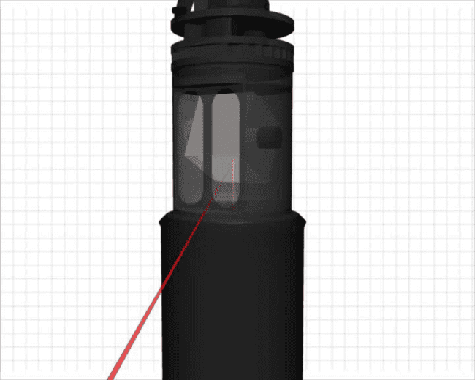
Introduction to LiDAR
animation
From profiles to 3D scans
A mirror rotating around two axes (terrestrial laser scanning)

Slide 18
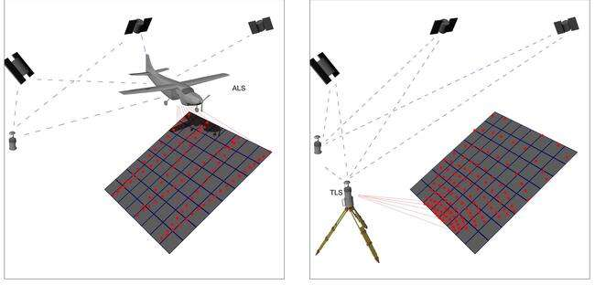
Introduction to LiDAR
From profiles to 3D scans
range measurement + 2 angle rotations

Slide 19
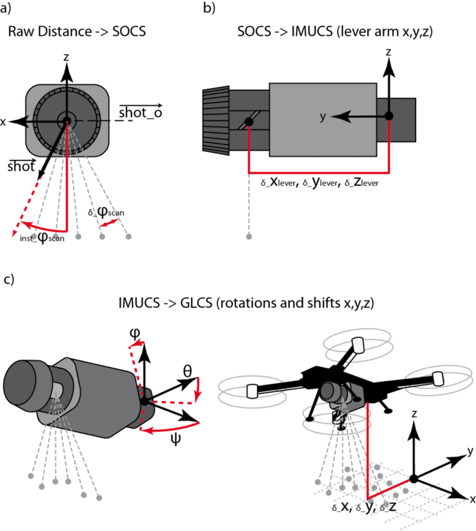
Introduction to LiDAR
Example: UAV LiDAR
Range measurement
Angle measurement (1 Rotation)
Inertial measurement by IMU
Global Positioning by dGNSS
Bremer, M., Wichmann, V., Rutzinger, M., Zieher, T., Pfeiffer, J. (2019): SIMULATING UNMANNED-AERIAL-VEHICLE BASED LASER SCANNING DATA FOR EFFICIENT MISSION PLANNING IN COMPLEX TERRAIN. Int. Arch. Photogramm. Remote Sens. Spatial Inf. Sci., XLII-2/W13, 943–950, 2019

Slide 20
Introduction to LiDAR
range
measurement
range measurement + angle of mirror
range measurement + angle of mirror + IMU measurement
range measurement + angle of mirror + IMU measurement + GNSS measurement
From point to point cloud
Example: Airborne LiDAR

Slide 21
Introduction to LiDAR
Comparison of terrestrial and airborne scan pattern

Slide 22
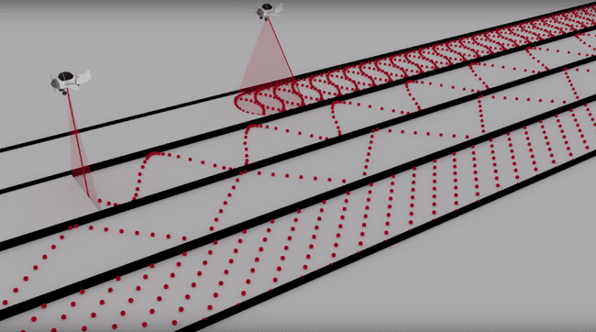
Introduction to LiDAR
Some airborne scan pattern:

Slide 23
From point clouds to scan projects
This is an open access presentation under the CC BY license (http://creativecommons.org/licenses/by/4.0/)

Slide 24
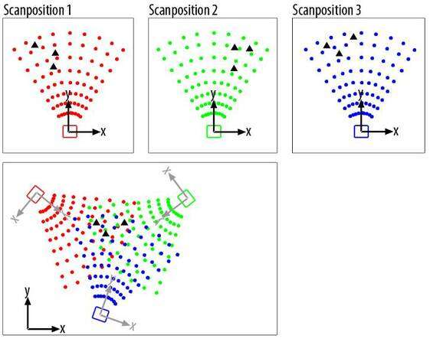
Introduction to LiDAR
From point clouds to scan projects: Registration
Adjustment based on at least 3 homologues points per scan (black triangles).
Horn, B.K.P. (1987): Closed-form solution of absolute orientation using unit quaternions. Journal of the Optical Society of America A4, 629–642.

Slide 25
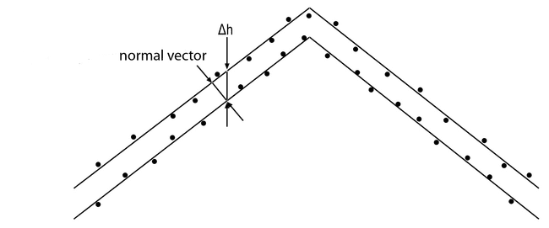
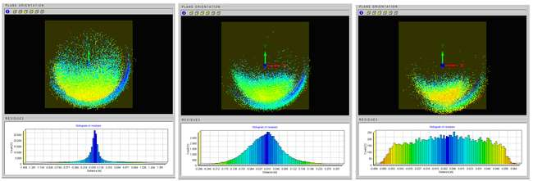
Introduction to LiDAR
Besl, P.J., McKay, N.D. (1992): A Method for Registration of 3D-Shapes. IEEE Transactions on Pattern Analysis
and Machine Intelligence. 14, 239–256
From point clouds to scan projects: Fine adjustment
Iterative Closest Point (ICP)
Iteratively minimizing the distance between two point clouds
Multi-Station-Adjustment uses bundle adjustment.

Slide 26
Laser beam characteristics
This is an open access presentation under the CC BY license (http://creativecommons.org/licenses/by/4.0/)

Slide 27
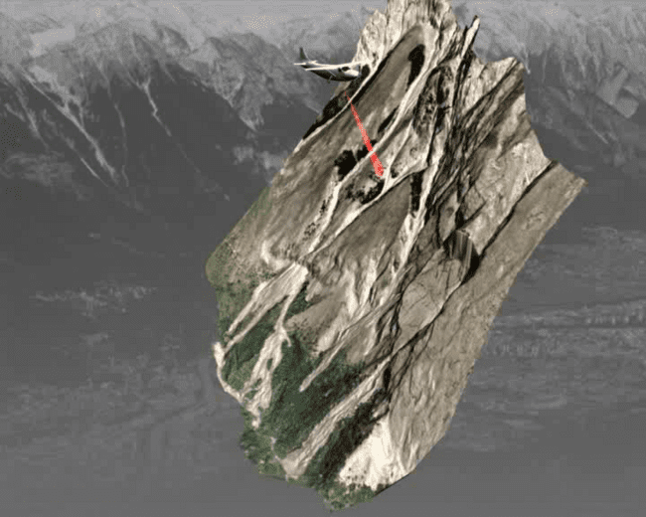
Introduction to LiDAR
Laserbeam characteristics and their implications
The laser beam shows a beam widening (spot light).
The spot on the scanned object is called ‘laser beam footprint’

Slide 28
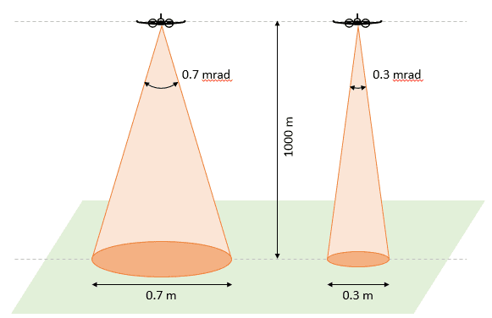
Introduction to LiDAR
Laser beam characteristics and their implications
The backscattered signal can be a mixture of different ranges:
reflected from e.g. twigs
reflected from e.g. the ground
[source: https://felix.rohrba.ch/en/2015/lidar-footprint-diameter/]

Slide 29
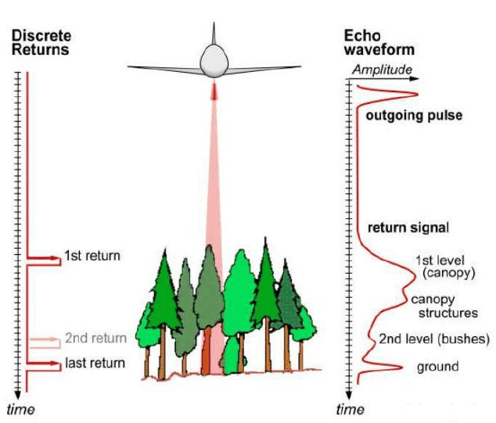
Introduction to LiDAR
Laser beam characteristics and their implications
The shape of the backscattered signal (wave-form) looks different, compared to the outgoing signal
The waveform can be described by its amplitude and echo width.
Additionally, the pulse shape deviation is used.
Ferraz, A., Bretar, F., Jacquemoud, S., Gonçalves, G. (2009):
The Role of Lidar Systems in Fuel Mapping. ISSN: 1645-2631

Slide 30
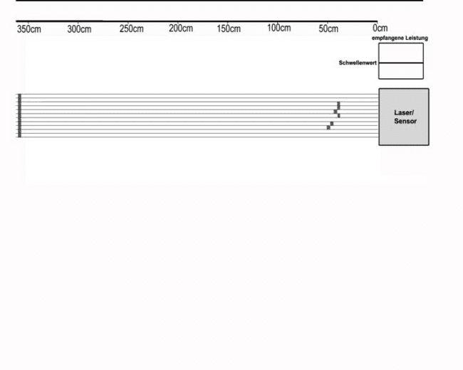
Introduction to LiDAR
animation
Laserbeam characteristics and their implications
The shape of the backscattered signal (wave-form) looks different different compared to the outgoing signal

Slide 31
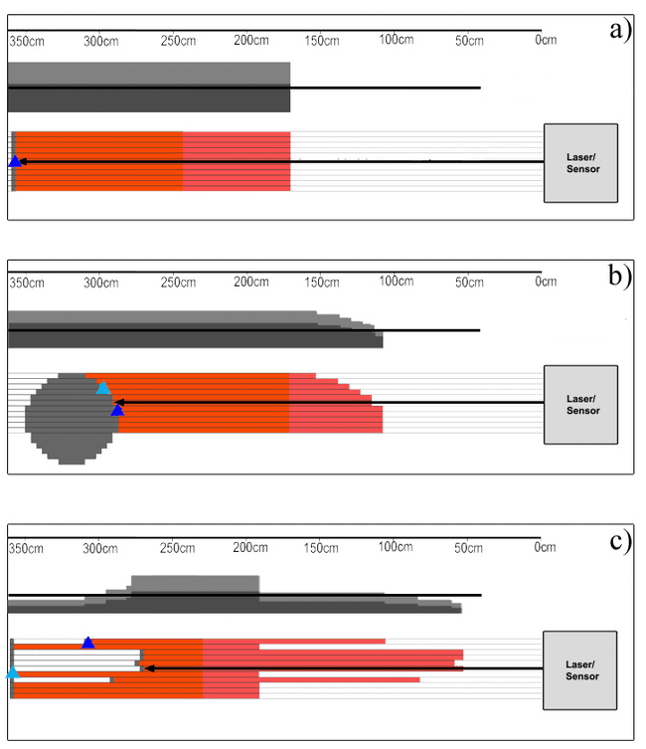
Introduction to LiDAR
detected wave-form
Laserbeam characteristics and their implications
Pulse shape deviation
The emitted laser pulse has a defined shape.
Depending on the geometry of a backscattering object, the shape of the pulse is changed.
detected wave-form
detected wave-form

Slide 32
Introduction to LiDAR
Laserbeam characteristics and their implications
State-of-the-art full-wave-form processing algorithms can detect the peaks of this complex waveforms and convert it into range measurements.
Ferraz, A., Bretar, F., Jacquemoud, S., Gonçalves, G. (2009):
The Role of Lidar Systems in Fuel Mapping. ISSN: 1645-2631

Slide 33
Introduction to LiDAR
Laserbeam characteristics and their implications
Discrete return scanners cannot detect the waveform
They use analog signal detection: A return is detected, if a threshold at the detector is exceeded.
Multiple return
First-Last Return
(source: carbomap)

Slide 34
Laser intensity data
This is an open access presentation under the CC BY license (http://creativecommons.org/licenses/by/4.0/)

Slide 35
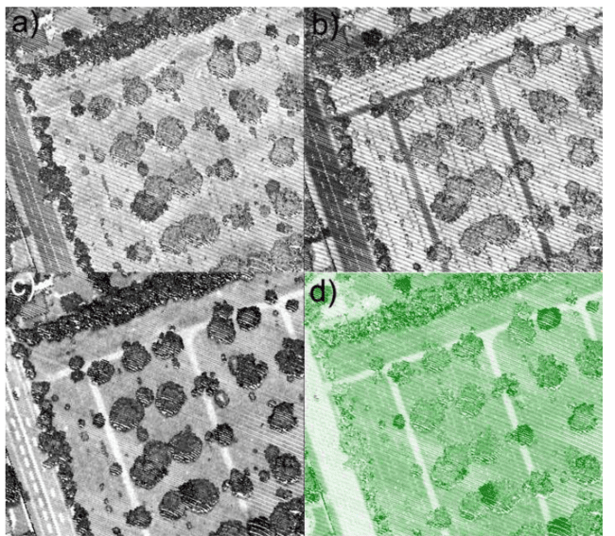
Introduction to LiDAR
Reflectance / Intensity of Return
The amplitude of a return can be used for further analysis (see next talk).
Therefore, the raw amplitude should be normalized by range.
1550nm
1064nm
532nm
Pseudo NDVI
Wichmann, V., Bremer, M., Lindenberger, J., Rutzinger, M., Georges, C., Petrini-Monteferri, F. (2015): Evaluating the potential of multispectral airborne LiDAR for topographic mapping and land cover classification,
ISPRS Annals of the Photogrammetry, Remote Sensing and Spatial Information Sciences, Volume II-3/W5, 2015.

Slide 36
Introduction to LiDAR
Laser intensity: from emitter to object
[source: https://felix.rohrba.ch/en/2015/lidar-footprint-diameter/]

Slide 37
Introduction to LiDAR
Laser intensity: object size and reflectivity
σ
[source: https://felix.rohrba.ch/en/2015/lidar-footprint-diameter/]

Slide 38
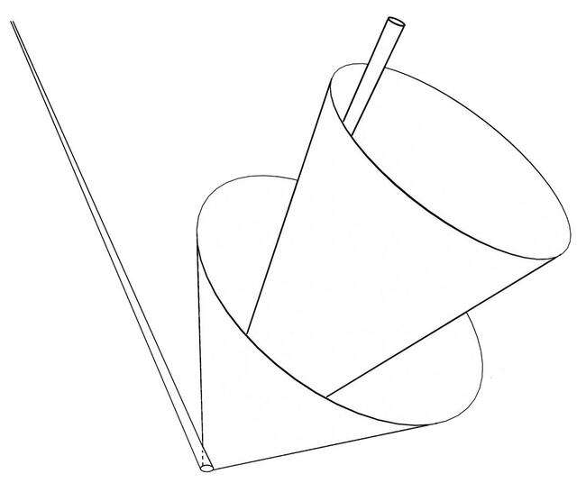
Introduction to LiDAR
emitter
receiver
Laser intensity: from object to detector
Lambertian or specular scatterer?
smooth surface
rough surface
footprint

Slide 39
Introduction to LiDAR
Aperture at receiver
Laser intensity: from object to detector

Slide 40
Introduction to LiDAR
Laser intensity: LiDAR equation
e.g. Wagner et al. 2003

Slide 41
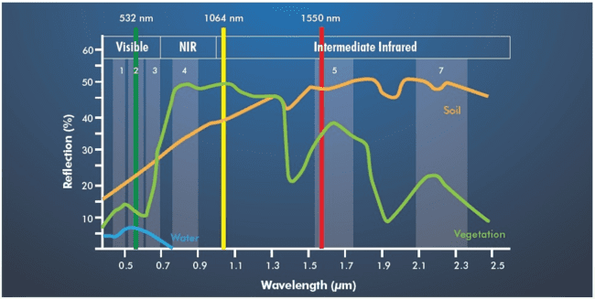
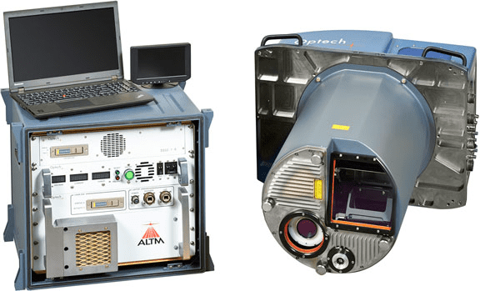
Introduction to LiDAR
Intensity on different wave length
Optech Titan
> 3 active beams with independent wavelengths of 532, 1064 and 1550 nm

Slide 42
Platforms and scales
This is an open access presentation under the CC BY license (http://creativecommons.org/licenses/by/4.0/)

Slide 43
Introduction to LiDAR
Platforms and scale
Space (e.g ICESat, GEDI
Airborne LiDAR
UAV-borne LiDAR
Terrestrial and mobile LiDAR
Earth

Slide 44
Introduction to LiDAR
Platforms and scale
ICESat
GEDI
ULS
MLS
ALS
TLS
> 10 hectare
1 hectare
Forest plot
(L. Terryn)

Slide 45
This is an open access presentation under the CC BY license (http://creativecommons.org/licenses/by/4.0/)

Slide 46
Some preparations and back ground info
Find the software in the software folder and download:
https://drive.google.com/drive/folders/1QfVQCMqMkD6QKDY9t0Eg2Nx0feaHs7f0

Slide 47
Data preparation and single tree delineation
How to run?
Extract the zip-files and simply run the saga_gui.exe

Slide 48
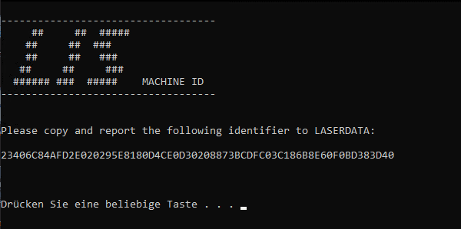
Data preparation and single tree delineation
How to activate our plug-in?
Case 1: Plugin a dongle (onsight)
Case 2: Run the machineid.exe by double clicking on it (for at home)
Copy and sent the printed machine ID code to me:
magnus.bremer@uibk.ac.at
I will sent back a licence file and add you to a list of the users!!

Slide 49
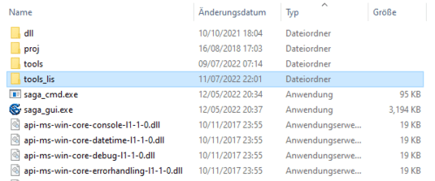
Data preparation and single tree delineation
How to activate our plug-in?
Find the tools_lis folder next to the saga_gui.exe!
Copy the LISLICENCE file into this folder!

