Slide 1
Data Preparation and Single Tree Delineation
Magnus Bremer
This is an open access presentation under the CC BY license (http://creativecommons.org/licenses/by/4.0/)

Slide 2
Data preparation and single tree delineation
Some preparations and back ground info
Find the software in the software folder and download:
https://drive.google.com/drive/folders/1QfVQCMqMkD6QKDY9t0Eg2Nx0feaHs7f0

Slide 3
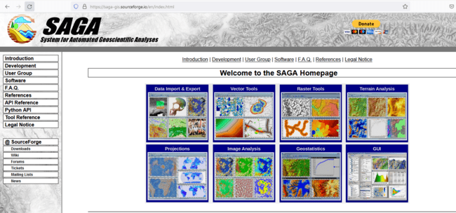
Data preparation and single tree delineation
Some background infos
SAGA GIS is an open source GIS for Windows/Linux
Unfortunately no Mac!

Slide 4
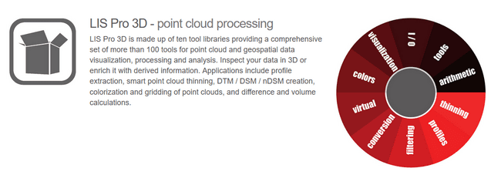
Data preparation and single tree delineation
Some background infos
A University of Innsbruck spin-off company (LASERDATA) hosts a plug-in for SAGA GIS called LIS Pro 3D (this is not open source)

Slide 5
Data preparation and single tree delineation
How to run?
Extract the zip-files and simply run the saga_gui.exe

Slide 6
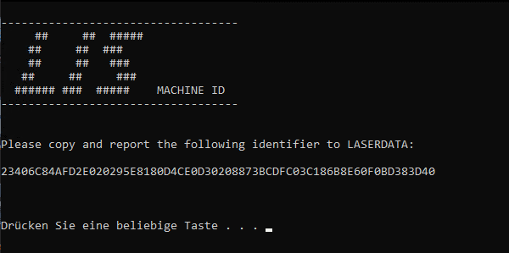
Data preparation and single tree delineation
How to activate our plug-in?
Case 1: Plugin a dongle (onsight)
Case 2: Run the machineid.exe by double clicking on it (for at home)
Copy and sent the printed machine ID code to me:
magnus.bremer@uibk.ac.at
I will sent back a licence file and add you to a list of the users!!

Slide 7
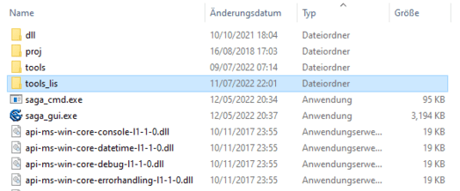
Data preparation and single tree delineation
How to activate our plug-in?
Find the tools_lis folder next to the saga_gui.exe!
Copy the LISLICENCE file into this folder!

Slide 8
Data preparation and single tree delineation
Now we should be ready to go!

Slide 9
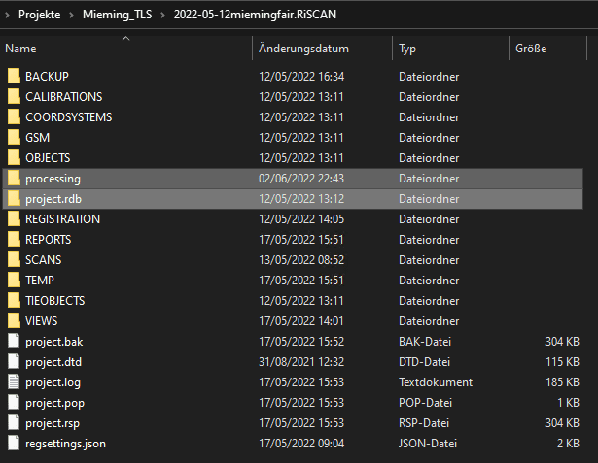
Data preparation and single tree delineation
Precondition: Your project has been registered in RiScan Pro, including Multi-Station-Adjustment!
Step 1: Data structure
The result rdbx-files (original-format) can be found in the project.rdb folder of your RISCAN project.
Create an additional folder called processing!

Slide 10
Data preparation and single tree delineation
Step 1: Data structure
The result rdbx-files (original-format) can be found in the project.rdb folder of your RISCAN project.
To find an individual ScanPos, you have to navigate through the sub folders of project.rdb!
e.g. to ScanPos001

Slide 11
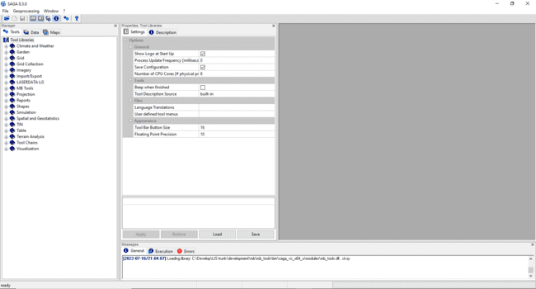
Data preparation and single tree delineation
Start the saga_gui.exe by double clicking on it! (The software will look like this)
Where your data can be visualized in maps
The tools to run
The settings of your tools
Where messages are printed

Slide 12
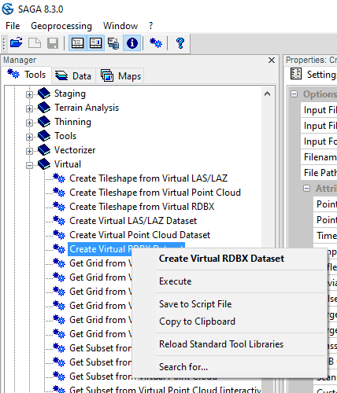
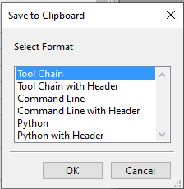
Data preparation and single tree delineation
Start the saga_gui.exe by double clicking on it! (The software will look like this)
Note that all the tools can also be run via command line (batch scripting) or python.
The template code in order to do this quickly can be copied to clipboard and pasted to a textfile / scriptfile.

Slide 13
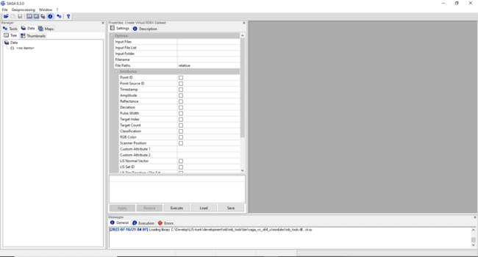
Data preparation and single tree delineation
Start the saga_gui.exe by double clicking on it! (The software will look like this)
Where your data can be visualized in maps
Where your data will appear
The settings of your data
Where messages are printed

Slide 14
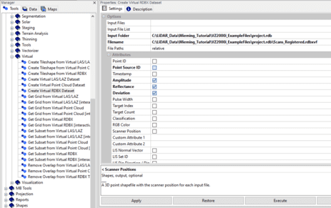
Data preparation and single tree delineation
Step 2: Virtual-RDBX
Register the whole scan project for smart access!
Tools > LASERDATA LiS > Virtual > Create Virtual RDBX Dataset

Slide 15
Data preparation and single tree delineation
Step 2: Virtual-RDBX
Register the whole scan project for smart access!
(In this tutorial, relevant parameter changes are shown in bold text!)
Select the project.rdb folder of your RISCAN-project!
Create a rdbxvf-file in the same folder!

Slide 16
Data preparation and single tree delineation
Step 2: Virtual-RDBX
Register the whole scan project for smart access!
Don’t forget to create Scanner Positions
Choose UTM-zone
With Helsinki-Data we might need +zone=35 instead!

Slide 17
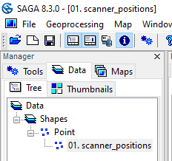
Data preparation and single tree delineation
Step 2: Virtual-RDBX
After Execution the Scan positions appear under the Data-Tab
Double click onto the scanner_positions entry to add it to a new map!

Slide 18
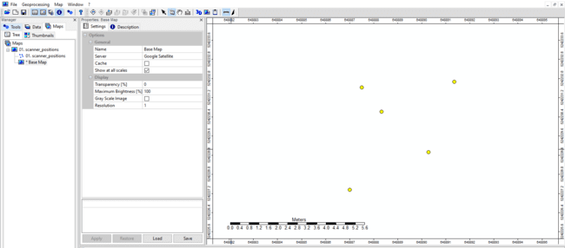
Data preparation and single tree delineation
Step 2: Virtual-RDBX
This project has 5 Scan positions

Slide 19
Data preparation and single tree delineation
Step 2: Virtual-RDBX
Right click onto the scanner_positions and click save as!
Therefore, create a new shapes-folder in the processing folder created before.

Slide 20
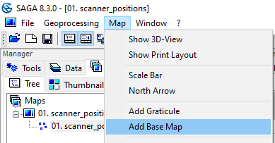
Data preparation and single tree delineation
Step 3: Add base map
Go to the Map menu to add a WMS Base Map such as Google Satellite!

Slide 21
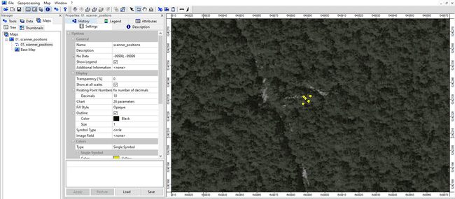
Data preparation and single tree delineation
Step 3: Add base map
Use the zoom tool to see, where your scan positions are located!

Slide 22
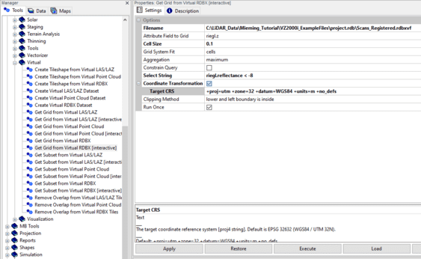
Data preparation and single tree delineation
Step 4: Create an Overview (DSM)
Tools > LASERDATA LiS > Virtual > Get Grid from Virtual RDBX [interactive]
Changes in bold-text
Provide the rdbxvf-file
Make a selection
Provide UTM-zone

Slide 23
Data preparation and single tree delineation
Step 4: Create an Overview (DSM)
After clicking onto the Execution button, the tool waits for dragging a selection box with the action tool (left mouse)

Slide 24
Data preparation and single tree delineation
Step 4: Create an Overview (DSM)
Execution could take some time!

Slide 25
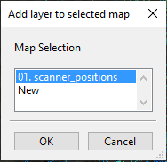
Data preparation and single tree delineation
Step 4: Create an Overview (DSM)
After Execution, an Overview Grid appears in the Data Tab!
Double click on it, to add it to the scanner positions map!

Slide 26
Data preparation and single tree delineation
Step 4: Create an Overview (DSM)

Slide 27
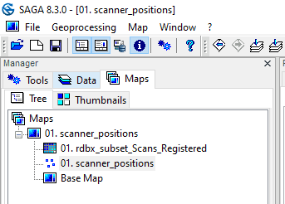
Data preparation and single tree delineation
Step 4: Create an Overview (DSM)
Go to the Maps tab (showing the order of layers) and drag the scanner_positions on top!

Slide 28
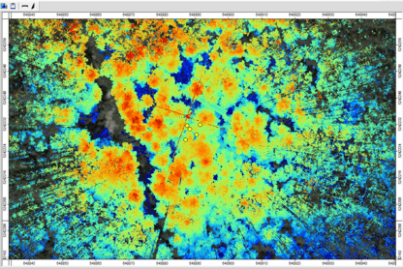
Data preparation and single tree delineation
Step 4: Create an Overview
You can see that there are a lot of far-away-points that should be ignored for analysis.
Lets make an appropriate selection!

Slide 29
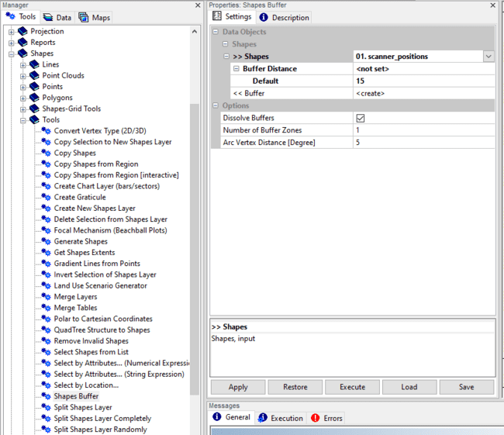
Data preparation and single tree delineation
Step 5: Create Region of Interest
Tools > Shapes > Shapes Buffer
Provide the scan positions!
Set a buffer distance of 15m
Dissolve buffers

Slide 30
Data preparation and single tree delineation
Step 5: Create Region of Interest
After execution, a new shapes layer appears that you can add to the map

Slide 31
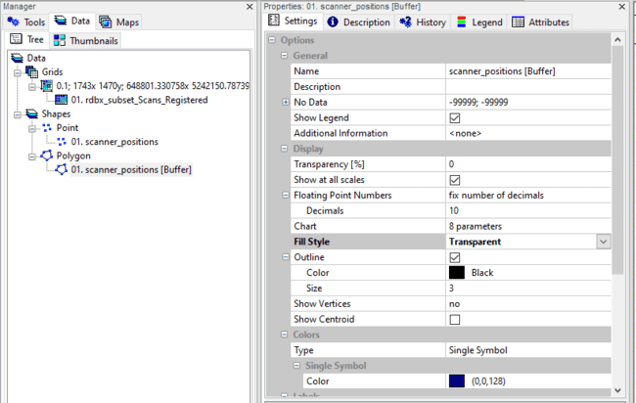
Data preparation and single tree delineation
Step 5: Create Region of Interest
With the buffer-layer selected,
change fill style to Transparent and Size to 3!

Slide 32
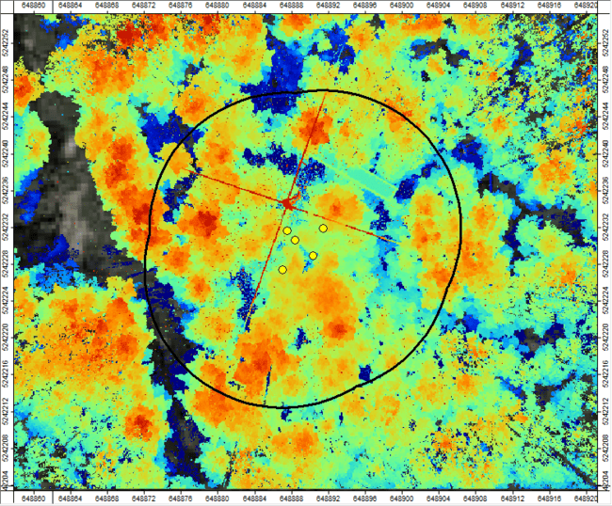
Data preparation and single tree delineation
Step 5: Create Region of Interest
This is a reasonable AOI for or scan project.
Save this AOI to the shapes folder created before!

Slide 33
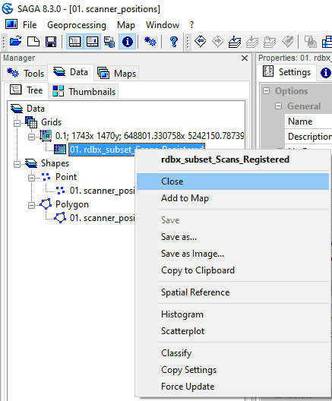
Data preparation and single tree delineation
Step 5: Delete Overview DSM
We will not need the overview DSM anymore. Close it!

Slide 34
Data preparation and single tree delineation
Step 6: Prepare and Filter Data
Tools > LASERDATA LiS > Automation > Ground Classification and Basic Filtering

Slide 35
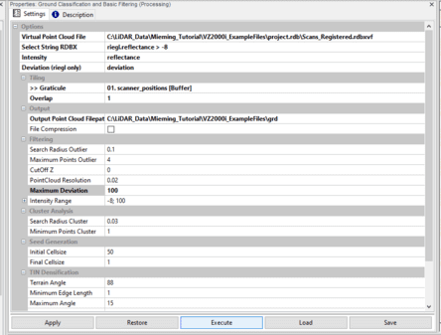
Data preparation and single tree delineation
Step 6: Prepare and Filter Data
Provide the rdbxvf-file (created before)!
Make a selection (e.g. on riegl.reflectance)
Provide the AOI as Graticule
Provide output folder

Slide 36
Data preparation and single tree delineation
Step 6: Prepare and Filter Data
Provide also your UTM Zone!
Execute!
Execution might take some time again!

Slide 37
Data preparation and single tree delineation
Step 7: Load Result Point Cloud
Note: After Execution the result point cloud is not directly loaded to the Graphical User Interface (The tool can process large areas, using a tiling scheme – thus, putting all results into the GUI makes no sense)
Load the result from your output folder (File Menu > Load)!

Slide 38
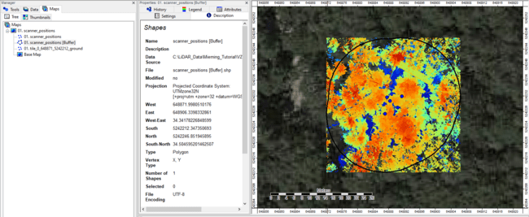
Data preparation and single tree delineation
Step 8: Add result point cloud to map

Slide 39
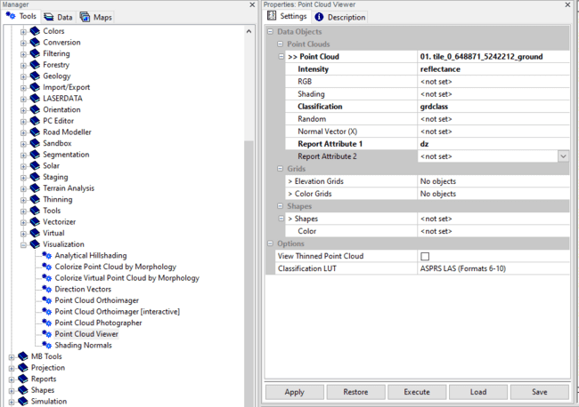
Data preparation and single tree delineation
Step 9: View result point cloud in 3D
Tools > LASERDATA LiS > Point Cloud Viewer

Slide 40
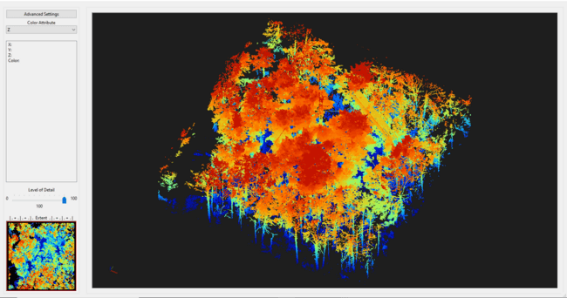
Data preparation and single tree delineation
Step 9: View result point cloud in 3D
Press P to switch to parallel perspective!

Slide 41
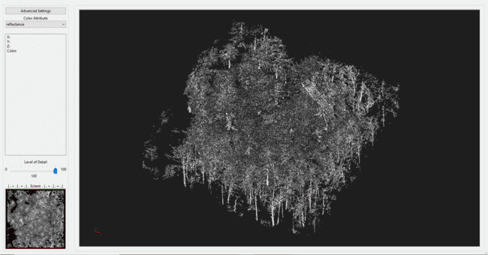
Data preparation and single tree delineation
Step 9: View result point cloud in 3D
Press 2 to switch to reflectance colored!

Slide 42
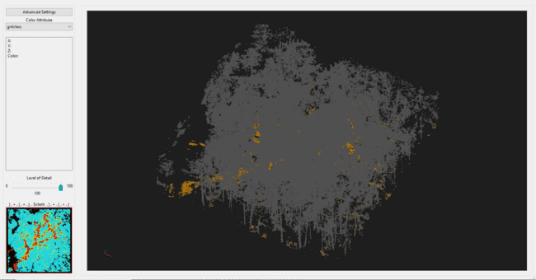
Data preparation and single tree delineation
Step 9: View result point cloud in 3D
Press 5 to switch to class colored!

Slide 43
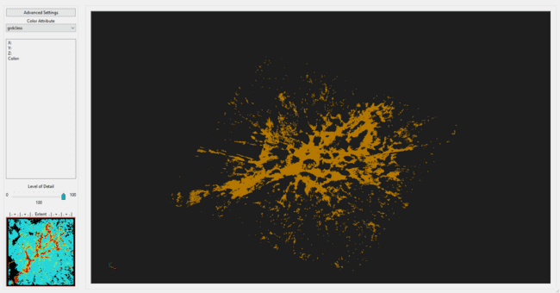
Data preparation and single tree delineation
Step 9: View result point cloud in 3D
Press 6 to to show only ground points!

Slide 44
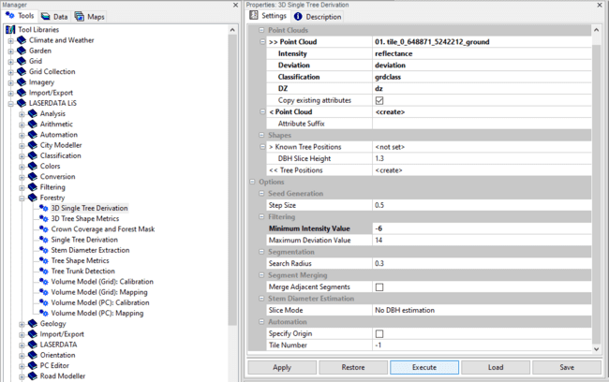
Data preparation and single tree delineation
Step 10: Tree Segmentation
Tools > LASERDATA LiS > Forestry > 3D Single Tree Derivation
You can play with the filter attributes and the search radius in tune the result!
Decrease step size if you have dense understory!

Slide 45
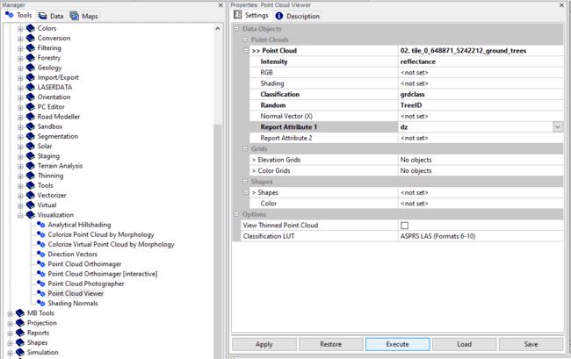
Data preparation and single tree delineation
Step 11: View segmented point cloud in 3D
Tools > LASERDATA LiS > Point Cloud Viewer

Slide 46
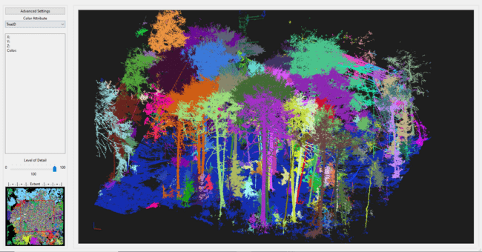
Data preparation and single tree delineation
Step 11: View segmented point cloud in 3D
Press Q to to show the tree segments!
Make a sub selection in the lower left selection window

Slide 47
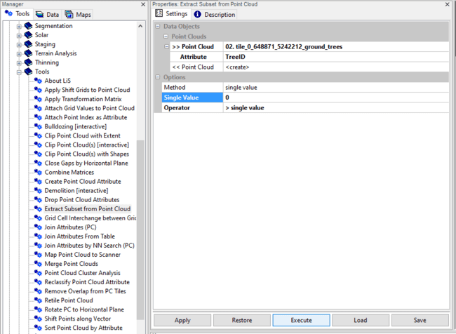
Data preparation and single tree delineation
Step 12: Extract points with valid Tree IDs
Tools > LASERDATA LiS > Tools > Extract Subset from Point Cloud
Note: You can also select only a single tree by its ID

Slide 48
Data preparation and single tree delineation
Step 13: Export selection result to RDBX
Tools > LASERDATA LiS > Import/Export > RDBX Info
Provide an exemplary rdbx-file (e.g. scanposition 1) from your project.rdb
Check the output Matrix

Slide 49
Data preparation and single tree delineation
Step 13: Export to result to RDBX
In the Data tab a Table appears, representing the transformation matrix from scanner coordinates to global coordinates of the RiSCAN Registration

Slide 50
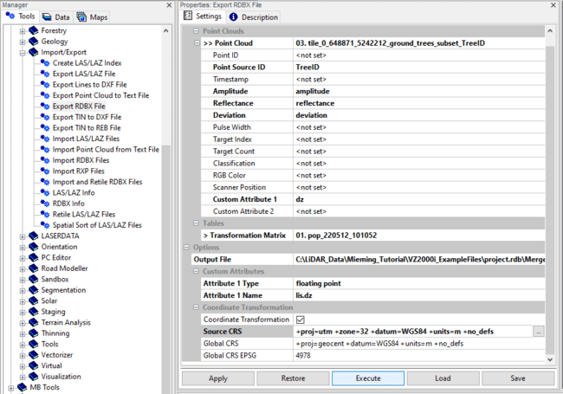
Data preparation and single tree delineation
Step 13: Export to result to RDBX
Tools > LASERDATA LiS > Import/Export > Export RDBX
Provide file to export
Tree ID as Point Source ID
Provide the Matrix
Provide Output Path
Provide your UTM-Zone
View Result in CloudCompare

Slide 51
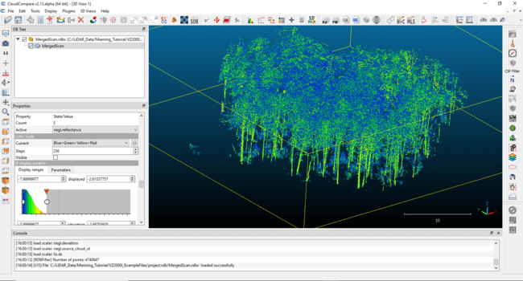
Data preparation and single tree delineation
Step 14: View Result in CloudCompare

Slide 52
This is an open access presentation under the CC BY license (http://creativecommons.org/licenses/by/4.0/)

